Slide 1

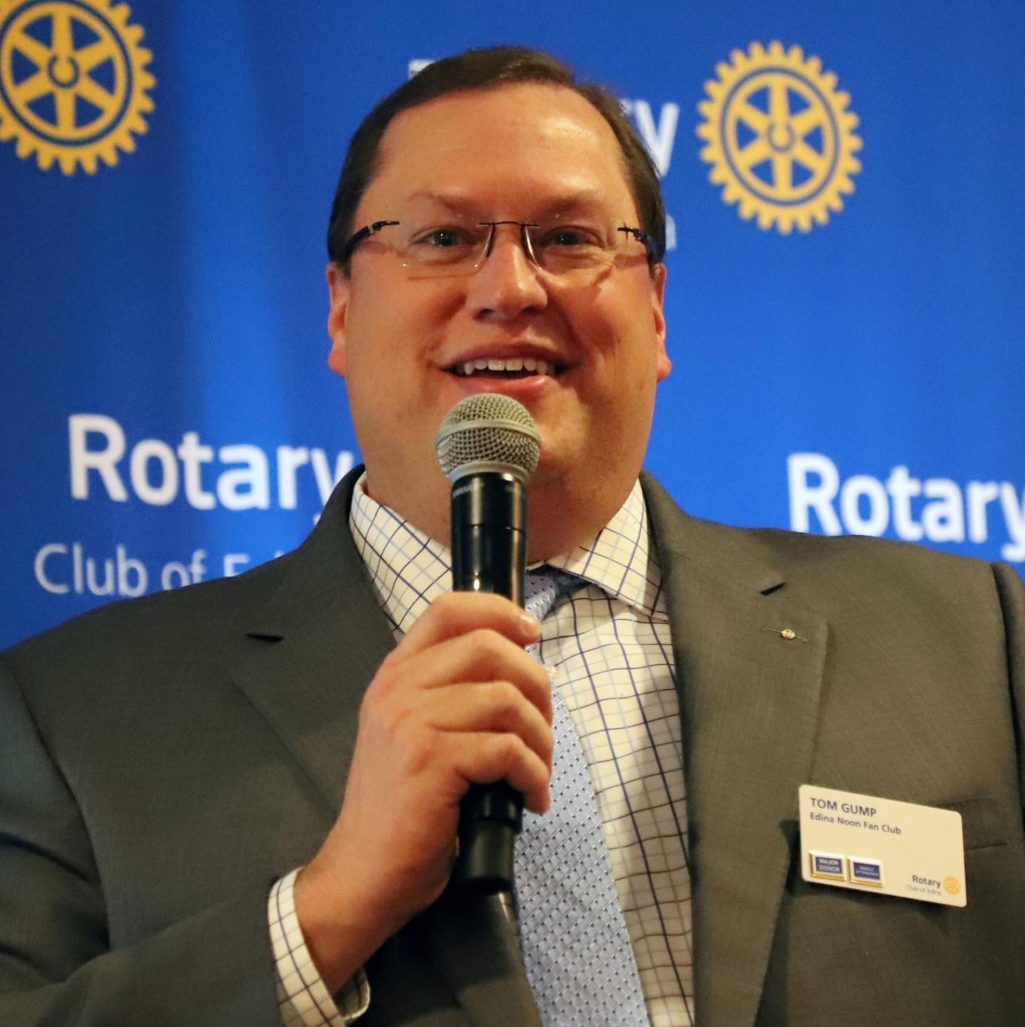

ROTARY MEMBERSHIP
TODAY & TOMORROW
A Conversation with
Tom Gump
Aide to Rotary International President 2024-25
Rotary International Membership Growth Committee Member
Notes:
Thank you for inviting me to be with all of you here today to discuss my all-time-favorite topic – Rotary Membership.

Slide 2
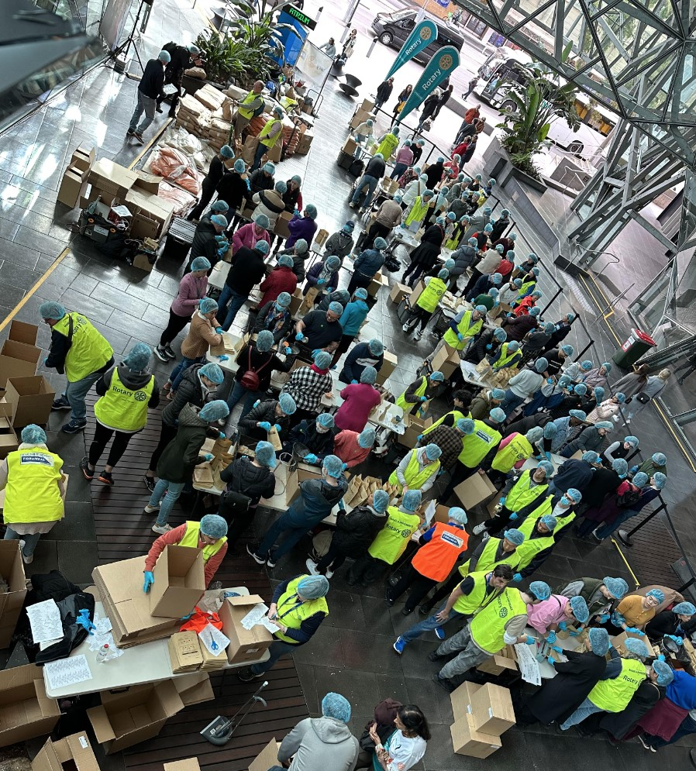
TODAY
1.4 MILLION MEMBERS
Working together:
> 1.4 million Members
in > 48,000 clubs
bringing positive change to communities worldwide.
Notes:
We also want to remind you as we move through the day that with every topic we discuss, we’re talking “Members,” we are talking about both Rotary and Rotaract clubs. As of 1 July, 2023 Rotaract is a distinct membership type. We are the association of Rotary AND Rotaract clubs with a global membership of just under 1.2 million people.
That’s about __. __ million Rotarians and _00,000 Rotaractors in more than 36,000 clubs.
So instead of having a separate session about Rotaract, we’ll weave it in to all our discussions to be more inclusive and all-encompassing.
Let’s move on and talk about mobilizing our membership efforts in your districts.

Slide 3
1.
ATTRACT
NEW
MEMBERS
3.
FORM
NEW CLUBS
2.
ENGAGE CURRENT
MEMBERS
WE NEED TO GROW!
ONLY THREE WAYS
TO DO IT:

Slide 4
1.
ATTRACT
NEW
MEMBERS
CLUB EXPERIENCE
CLUB EXPERIENCE
CLUB EXPERIENCE
MATTERS
3.
FORM
NEW CLUBS
2.
ENGAGE CURRENT
MEMBERS
CLUB EXPERIENCE

Slide 5
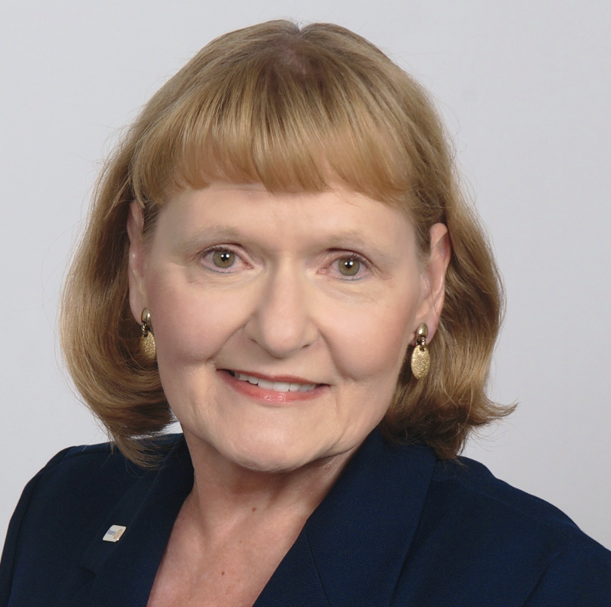
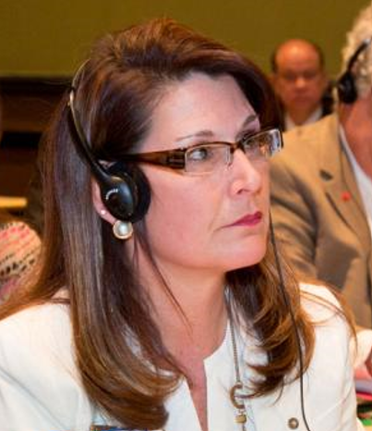
How are we Going to grow?
thru using the action plan!
RIPE Stephanie Urchick
TOMORROW
GLOBALLY
Director Elect Chris Etienne
Notes:
STEPH - We also want to remind you as we move through the day that with every topic we discuss, we’re talking about both Rotary and Rotaract clubs. As of 1 July, Rotaract is a distinct membership type. We are the association of Rotary AND Rotaract clubs with a global membership of around 1.4 million people.
That’s about 1.2 million Rotarians and 200,000 Rotaractors in more than 46,000 clubs.
So instead of having a separate session about Rotaract, we’ll weave it in to all our discussions to be more inclusive and all-encompassing.
Let’s move on and talk about mobilizing our membership efforts in your districts.

Slide 6

WHY DO WE NEED THIS?
TO FOCUS CLUBS!

Slide 7

ONLY 35%
Rotary is an
organization for
people like me.
Notes:
Most had only a vague idea of exactly how we do good in the world. Only 35 percent saw Rotary as an organization for people like them.

Slide 8

ONLY 25%
Know someone
in Rotary
Notes:
And just 25 percent of people surveyed said they knew someone in Rotary. All of us here know how this is playing out in real life. Membership has dropped as much as 18 percent in North America and elsewhere. We set a record in 2018 for the number of people who left Rotary.

Slide 9
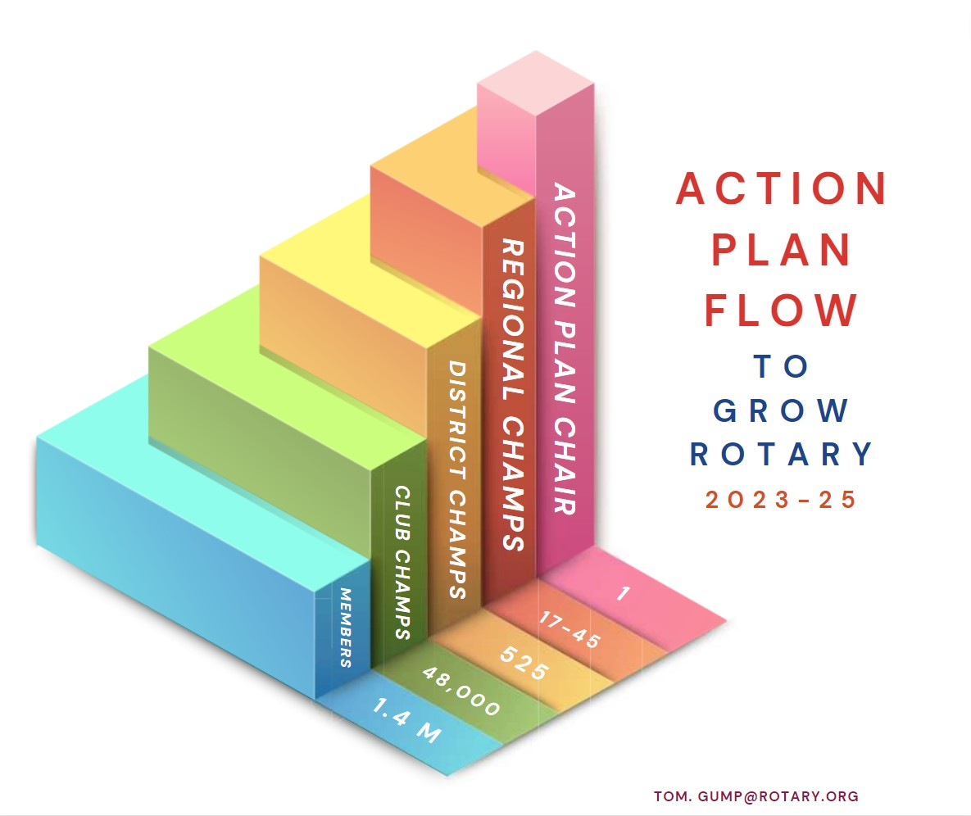
CLUB EXPERIENCE
HOW DOES
IT WORK?
3.
FORM
NEW CLUBS
2
ENGAGE CURRENT
MEMBERS
CLUB EXPERIENCE

Slide 10

CLUB EXPERIENCE
THE TOOL KIT
3.
FORM
NEW CLUBS
2
ENGAGE CURRENT
MEMBERS
CLUB EXPERIENCE

Slide 11

Together, we see a world where people unite and take action to create lasting change — across the globe,
in our communities,
and in ourselves.

Slide 12

FOUR
PRIORITIES
Notes:
It has four priorities. Four. Each priority reflects the input, feedback, and hopes of current and former members, leadership, Rotaractors, alumni, Youth Exchange students, and Rotary staff. In all, we reached out to more than a million people who are connected to Rotary in some way to ensure that our Action Plan priorities are the right ones, and are authentically Rotary. The four priorities are:

Slide 13

Increase
our impact
Expand
our reach
Enhance
participant
engagement
Increase
our ability
to adapt
Notes:
Increase our impact
Expand our reach
Enhance participant engagement, and
Increase our ability to adapt

Slide 14

From Priority to Action

Slide 15

ACTION PLAN PRIORITY 1:
INCREASE OUR IMPACT

Slide 17
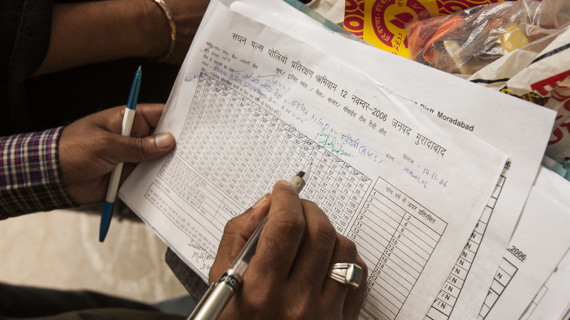
Notes:
But in a data-driven world, legacies must be measurable. To increase our impact and provide even more proof of what Rotarians are capable of achieving, we have to be more data driven.

Slide 18
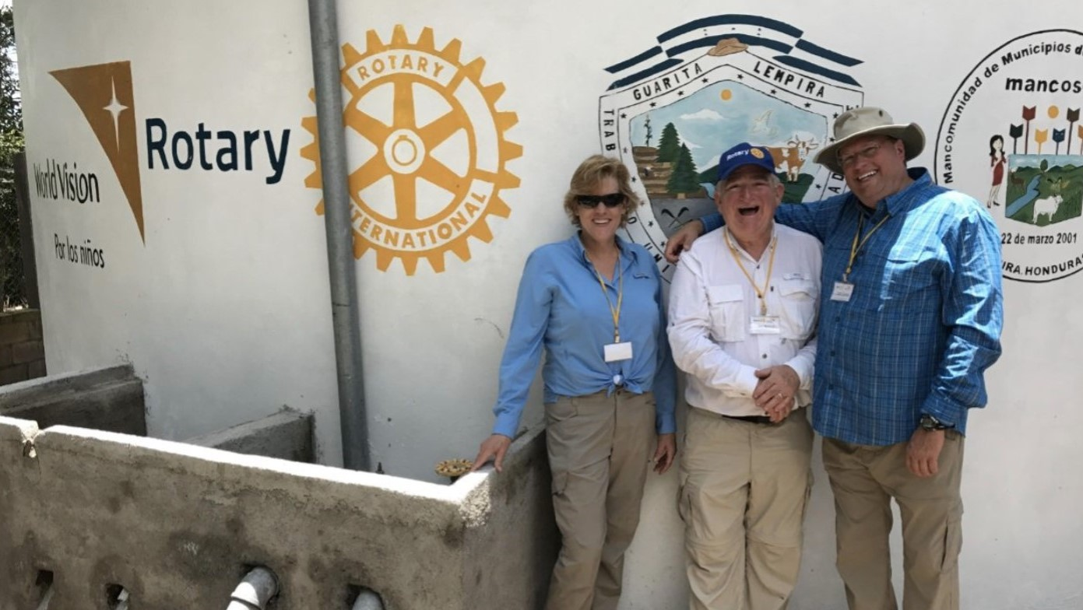
Notes:
There’s a lot we can do at the club level, too. We’re going to encourage a greater sense of focus — instead of clubs trying to do too many things and getting only halfway there. We’re going to help clubs collect more information on community impact and do pre- and post-activity evaluations, so they can tell compelling stories about the impact they are making.

Slide 19

Together, let’s prove that our impact
on the world has just begun.

Slide 20

ACTION PLAN PRIORITY 2:
EXPAND OUR REACH

Slide 21
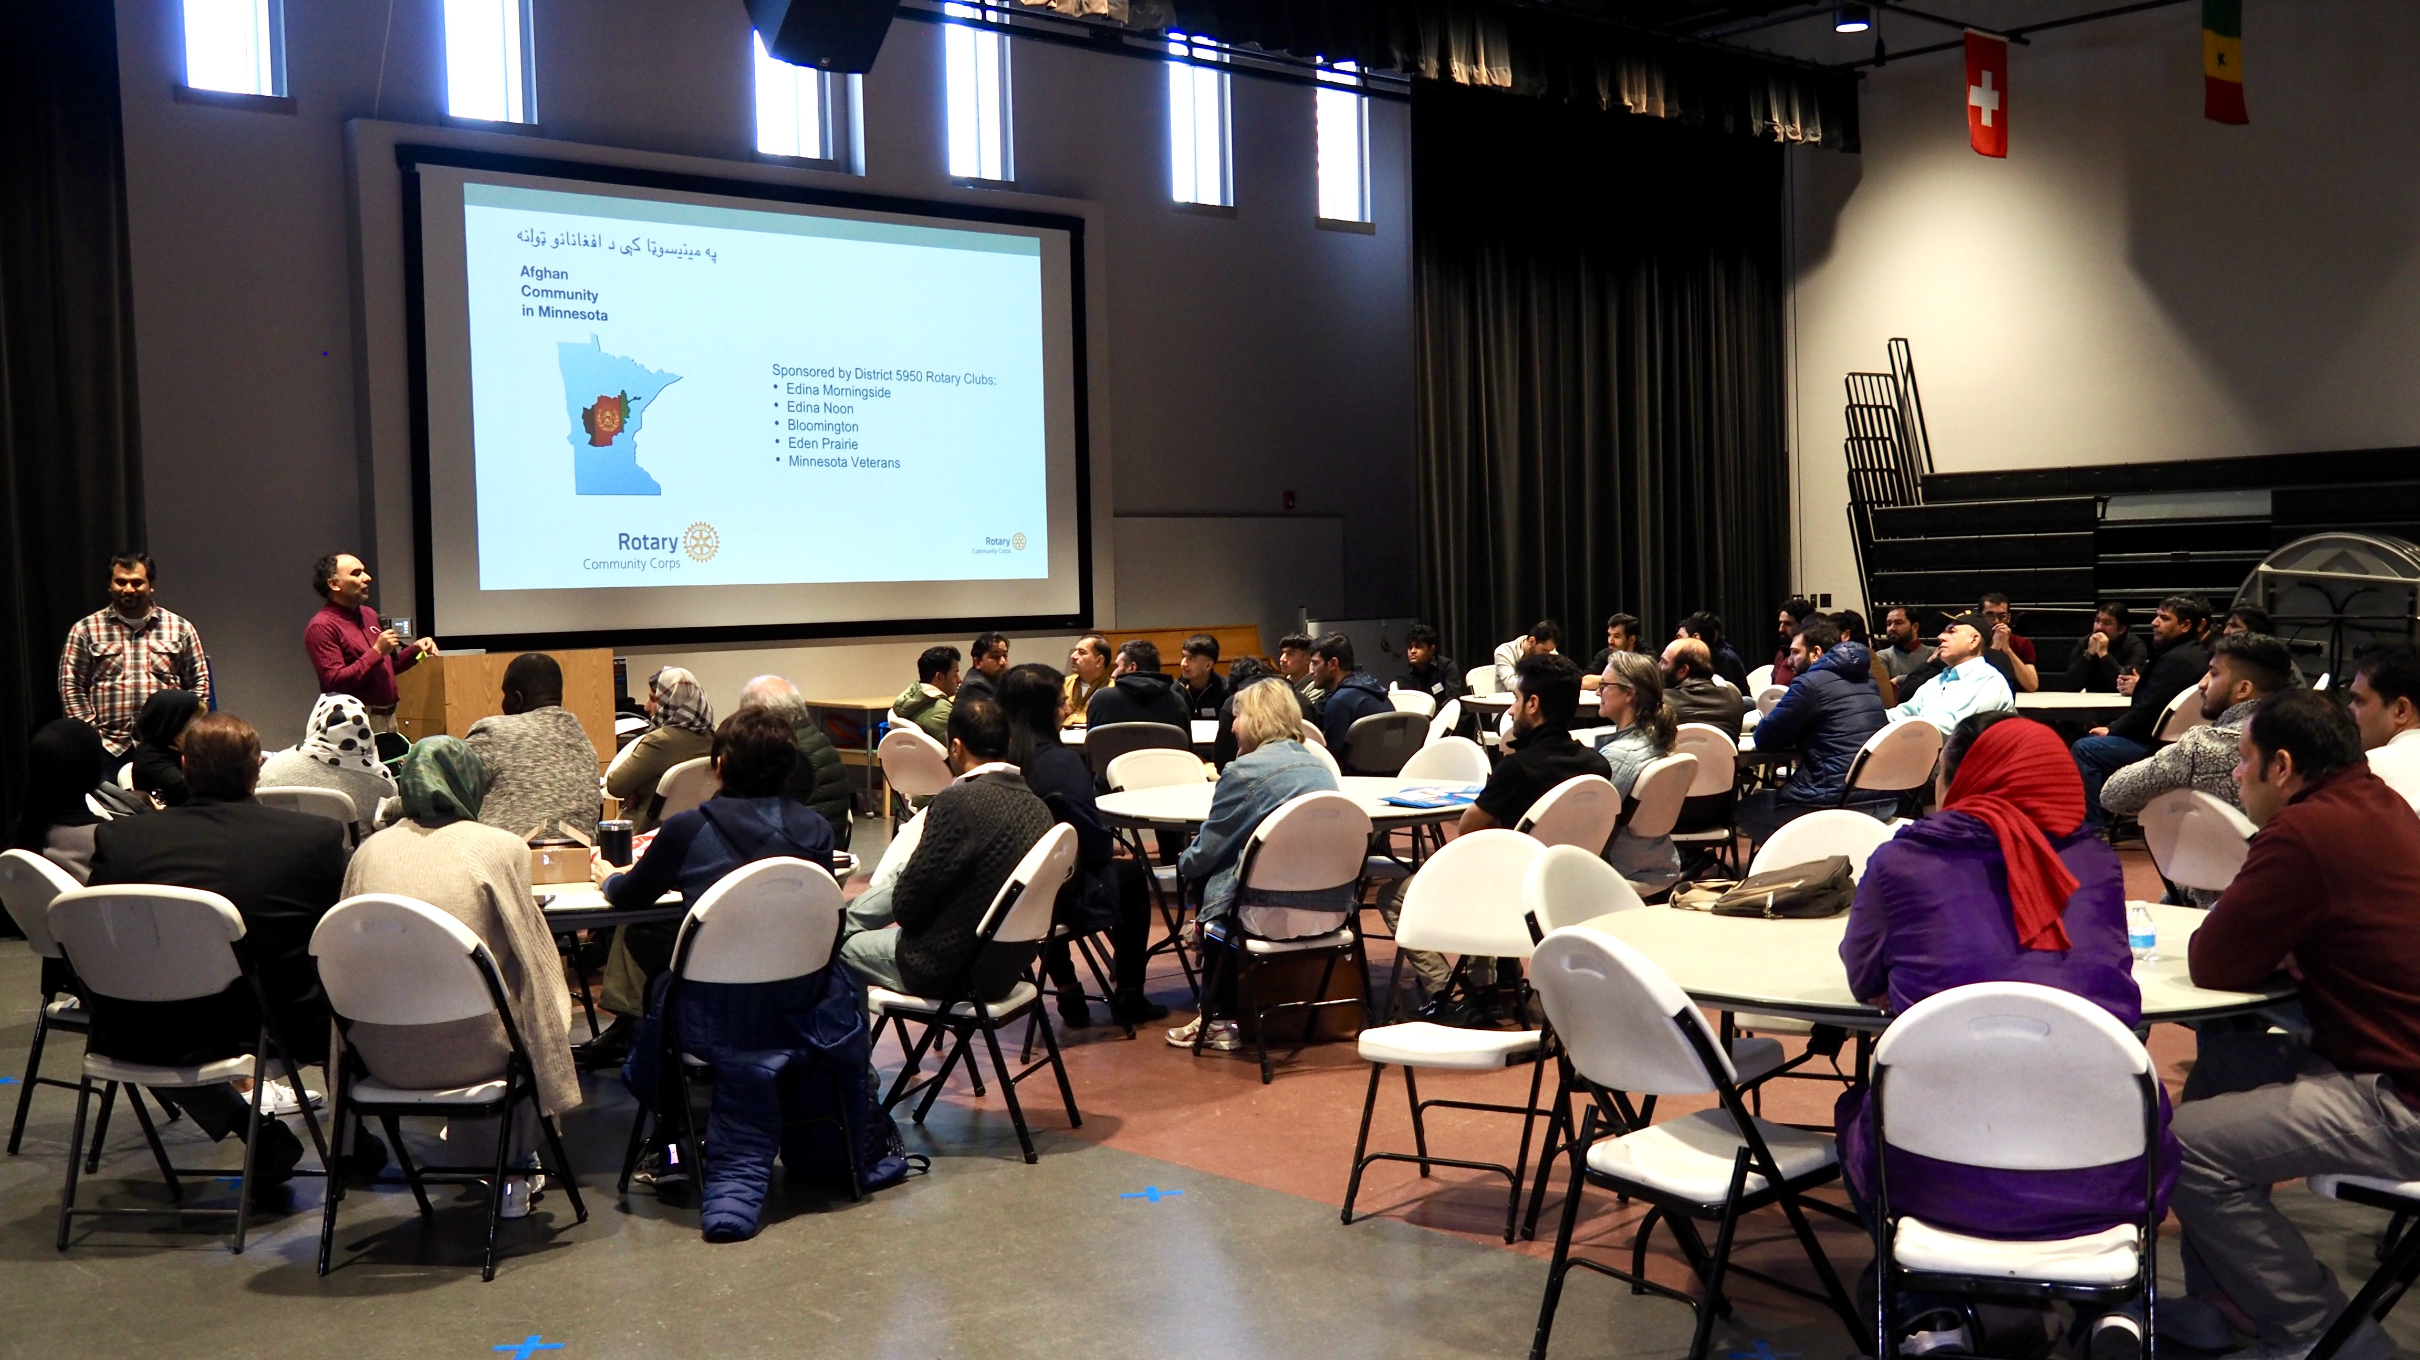
Notes:
Here’s another way to revitalize our clubs and share our values with new audiences: form partnerships with new organizations and agencies. Already, Rotary clubs partner with schools and universities, the local chamber of commerce, local governments, social service agencies, other volunteer organizations. That’s fantastic. But we need to encourage every club to do more to collaborate with and involve their communities. Let’s look around our communities and see all the ways that people are connecting — through shared professional goals, for example, or shared cultures or interests. And let’s invite those people to connect with us, too. When we think beyond traditional partnerships, we show we’re an open, engaging organization. We demonstrate that positive change starts with welcoming the talents and ideas of others.

Slide 22

Together, let’s build connections and opportunities that will allow people who
share our drive to do the same.

Slide 23

ACTION PLAN PRIORITY 3:
ENHANCE PARTICIPANT
ENGAGEMENT

Slide 24
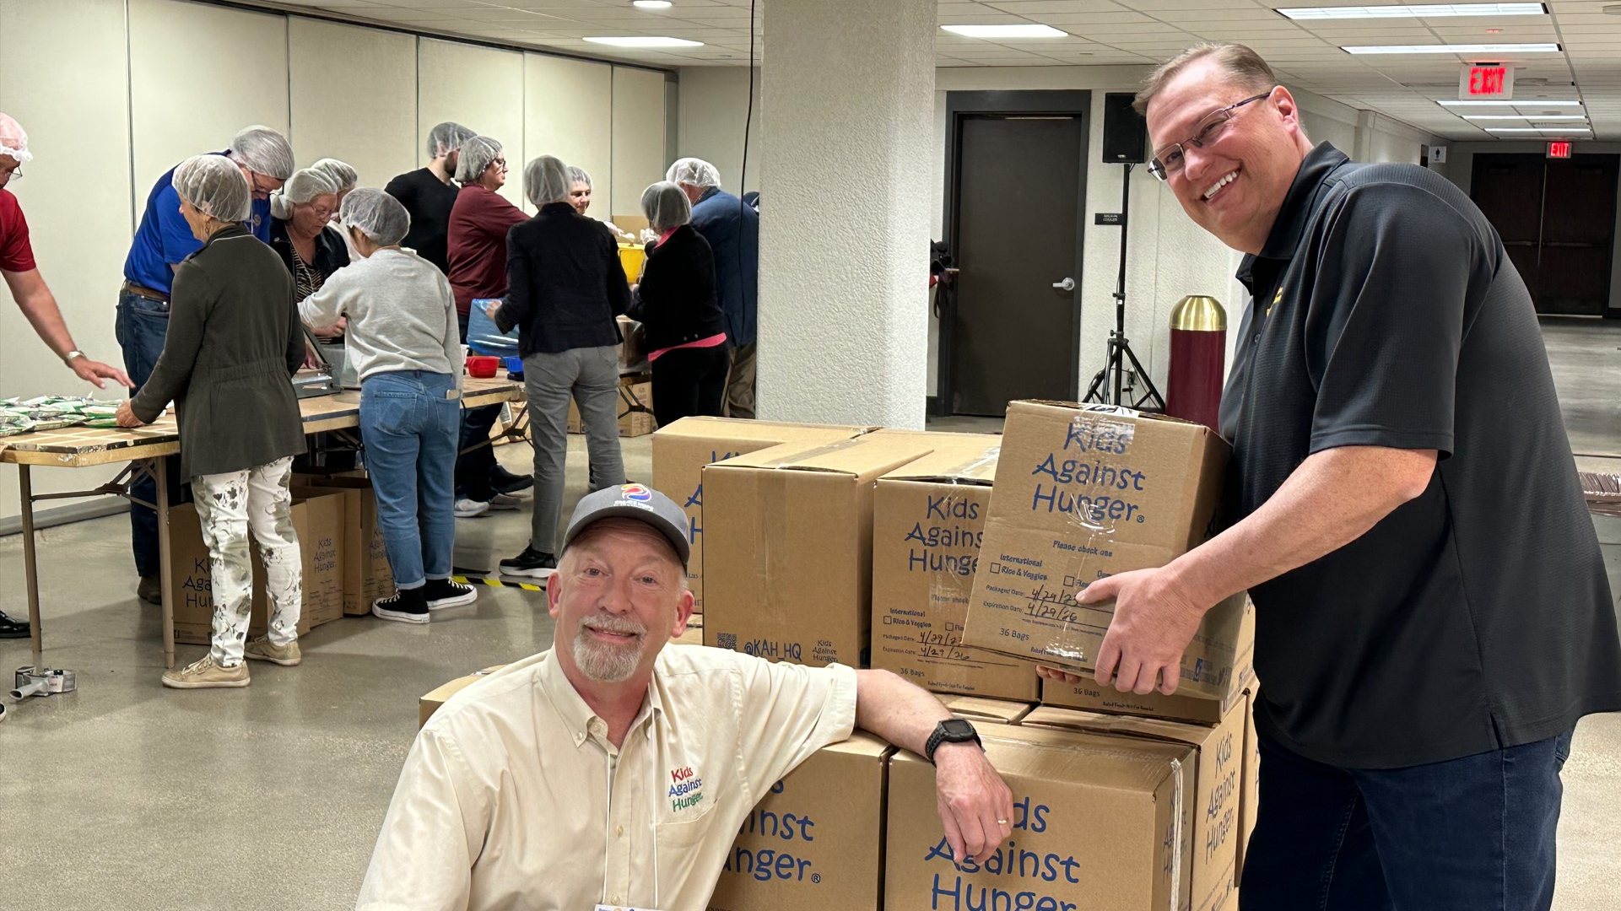
Notes:
As People of Action we strive to understand the needs of others. But just like the people and communities we serve, our fellow members need to know that they are seen, heard, and valued. They’re seeking experiences that feel personally and professionally relevant and fulfilling and, in some cases, we are not delivering on that need. This priority is aimed at making sure that we give our members meaningful opportunities to evolve and grow with us — personally and professionally — throughout their lives.

Slide 25
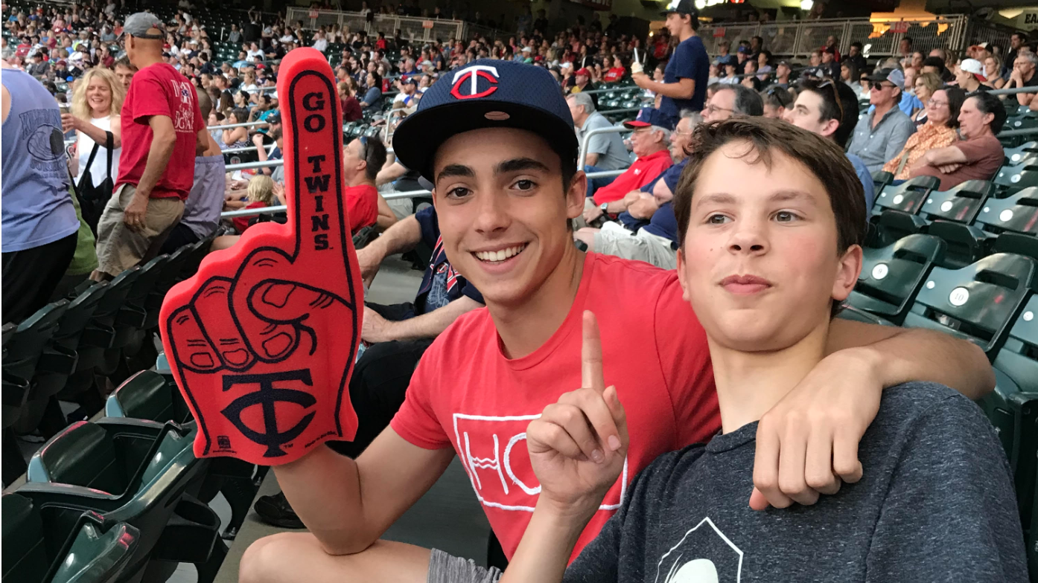
Notes:
But let’s not stop with our members. We want to improve the overall Rotary experience for anyone who affiliates with us. And we should take nothing for granted. We need to look at every encounter as an opportunity to show our people what Rotary can do for them — as individuals and as members of our communities.

Slide 26

Together, let’s recommit to
putting the needs, expectations,
and growth of our participants
at the center of all we do.

Slide 27

ACTION PLAN PRIORITY 4:
INCREASE OUR ABILITY
TO ADAPT

Slide 28
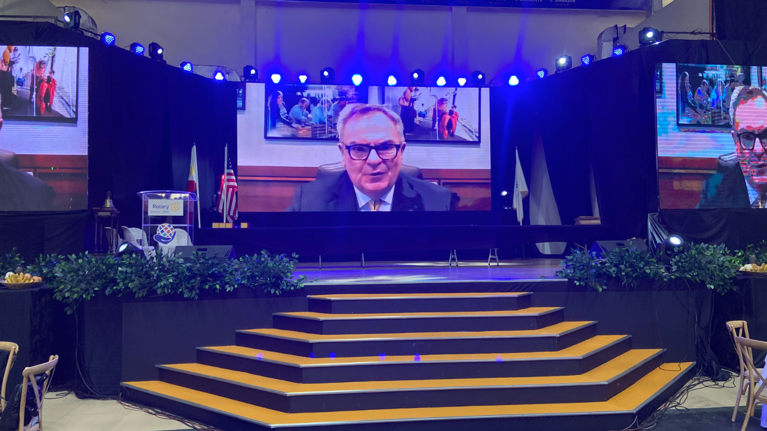
Notes:
We should also encourage our clubs to take a fresh look at club governance and look at ways to streamline it. They can create a fund to take some risks and try out new activity ideas. They can host the club meeting in a new location and at a new time. They can involve non-Rotarian advisers in club board meetings to gain new and different perspectives and ideas.

Slide 29
Together, let’s stay true to ourselves
and stay ahead of change
in our next 118 years.

Slide 30
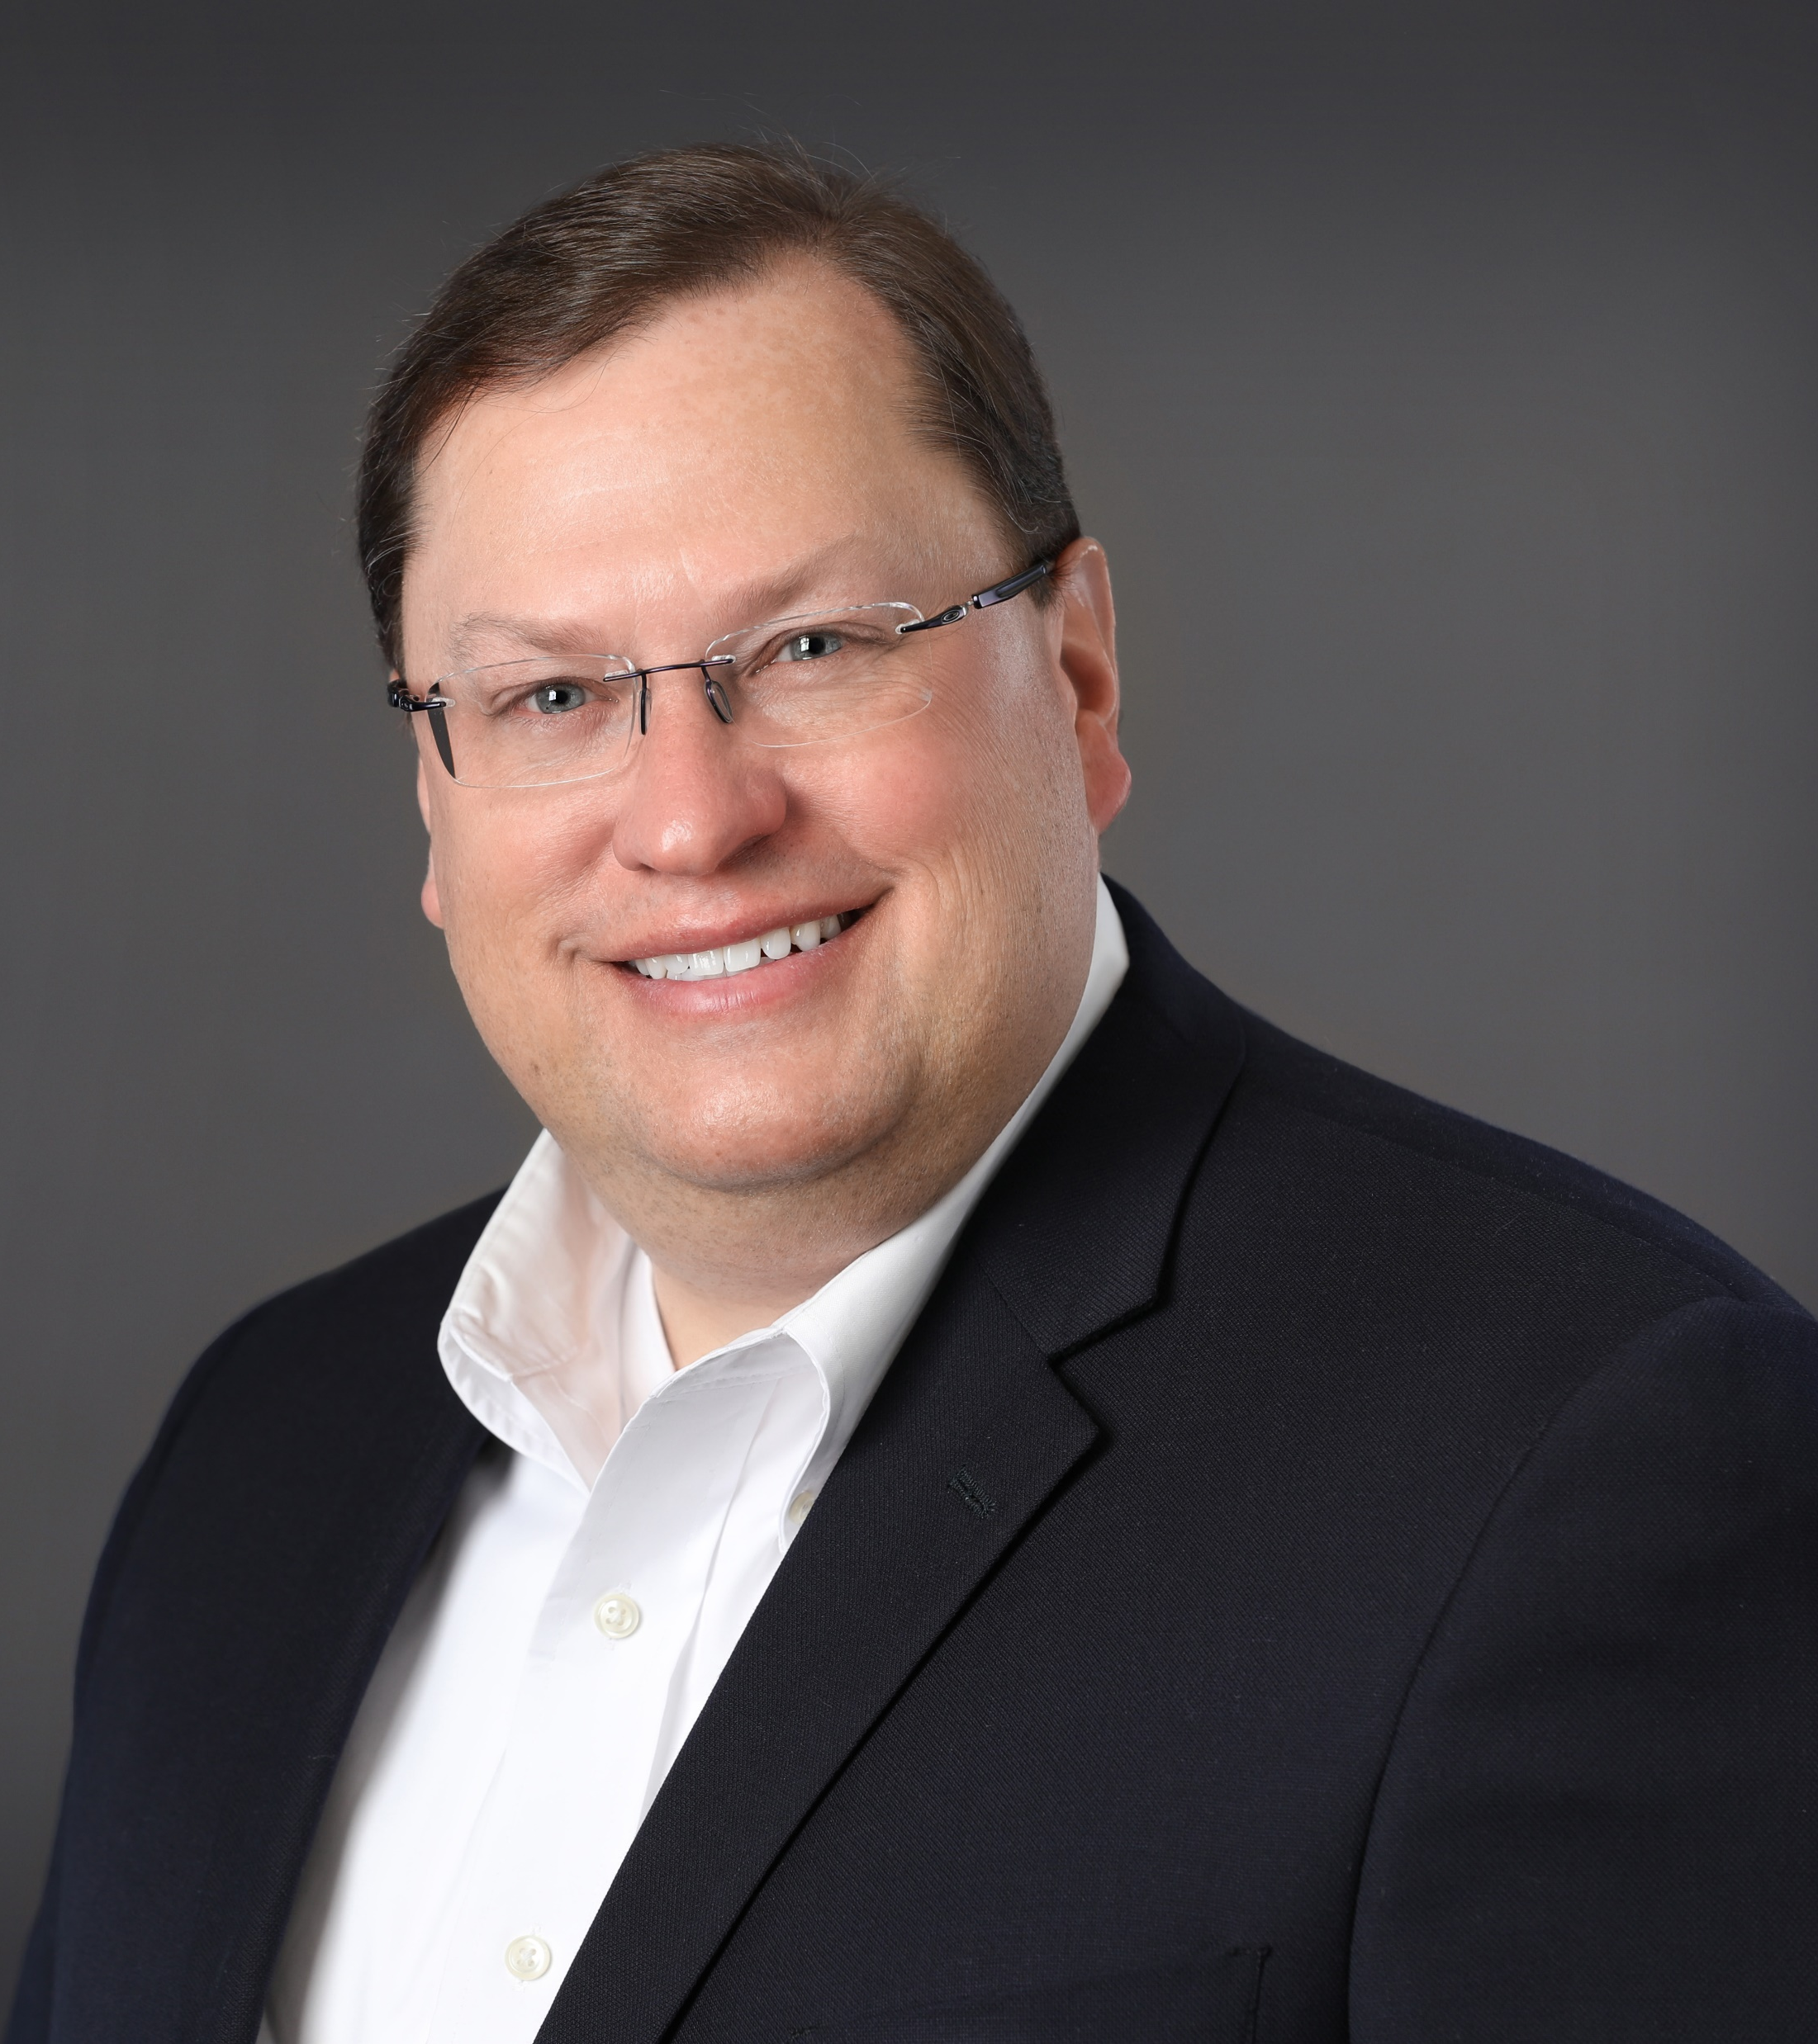
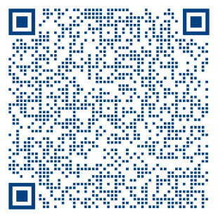
Thank You!
PDG Tom Gump
Aide, RI President 2024 - 2025
RI Membership Growth Committee
Tom.Gump@Rotary.org
1 (612) 770-8389

